Slide 1

Quantum
Error
Correction -
Surface Code
From fragile qubits to resilient computation — quantum error correction, and especially the surface code, paves the way to truly fault-tolerant quantum machines
Toward Fault-tolerant Quantum Computation
Asmaa Ali
Theoretical physics
Faculty of science - Mansoura university
August 2025

Slide 2
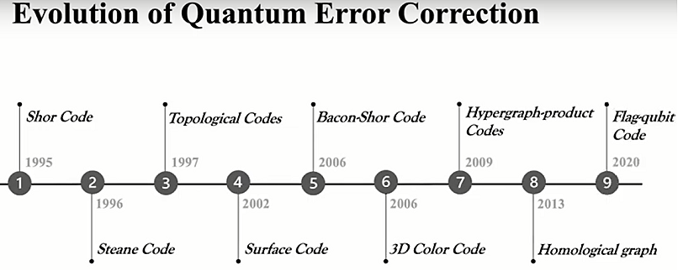
TIMELINE

Slide 3
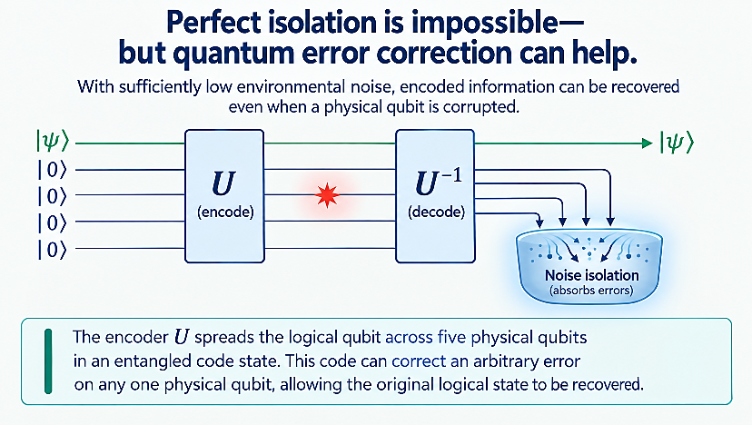
MOTIVATION
Charles Bennet

Slide 4
Aim:
By the end of this presentation, you should have a solid conceptual map moving from:
Classical fault tolerance → basics of repetition codes and code distance.
Quantum stabilizer codes → stabilizers, code space, and error detection.
Surface code → as a topological code enabling scalable fault-tolerance.
Keywords:
Code distance – Logical qubit – syndrome - stabilizer – Detector – Detection event –codewords – code space – Minimum weight perfect matching – threshold ,…

Slide 5
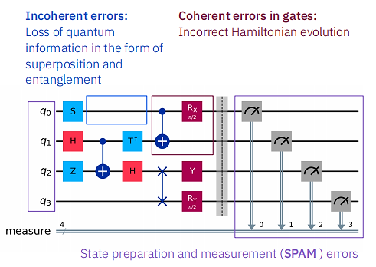
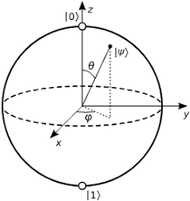
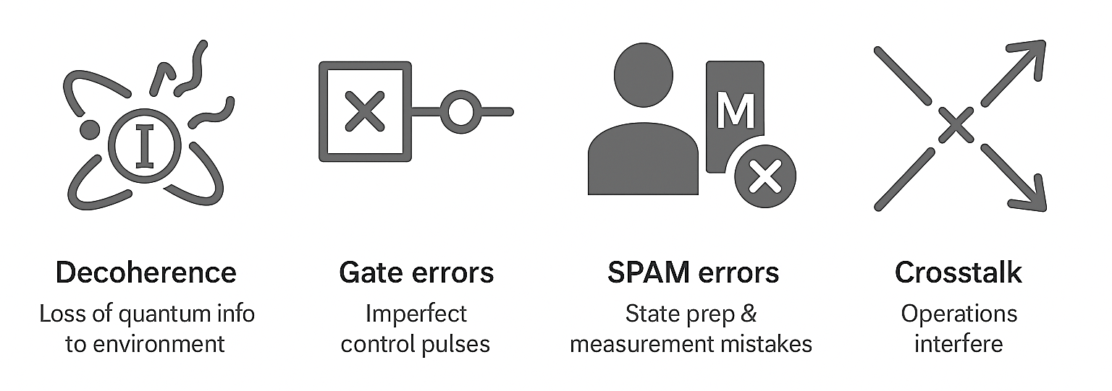
What are Quantum Errors?
Real Quantum Computers are not ideal!
Qiskit global summer school 2024 - IBM

Slide 6
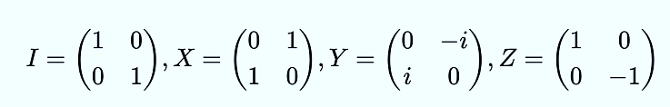
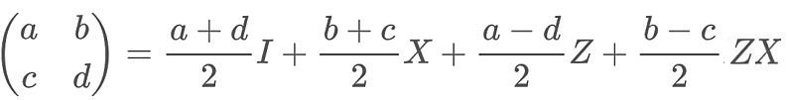
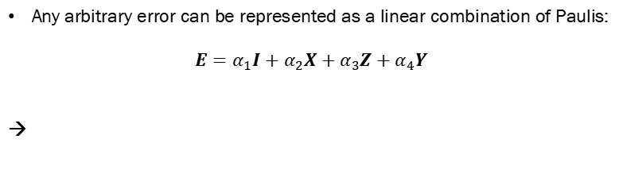
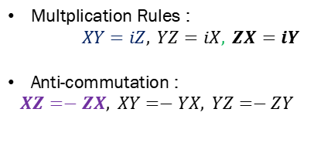
Decomposition of Errors
Pauli operations
Bit Flip
Phase-Flip
Multplication Rules :
$XY=iZ, YZ=iX, ZX=iY$
Anti-commutation :
$$XZ=−ZX, XY=−YX, YZ=−ZY$$
Both errors
Any arbitrary error can be represented as a linear combination of Paulis:
$$E=α_{1}I+α_{2}X+α_{3}Z+α_{4}Y$$
→
Austin Fowler - Google

Slide 7
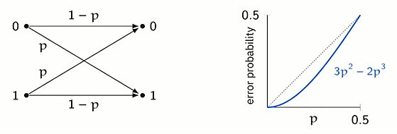


Classical Fault Tolerance – Massive Redundancy (Repetition Code)
bit
“Encoding”
“Decoding”
Binary noise symmetric channel
At most one bit-flip of any of the three bits.
Logical zero
Logical One

Slide 8
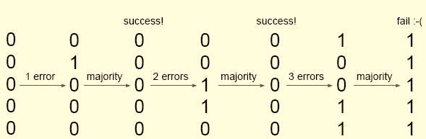
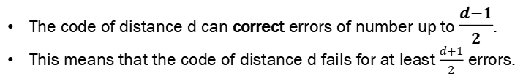
Fundamentals of Classical Error Correction – Code Distance
The code distance is the minimum number of physical errors that when combined cause an undetectable logical error.
Example of code distance d=5:
The code of distance d can correct errors of number up to $\frac{d−1}{2}$.
This means that the code of distance d fails for at least $\frac{d+1}{2}$ errors.

Slide 9
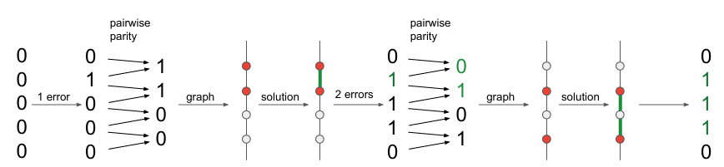
Fundamentals of Classical Error Correction – Decoding by MWPM
Other than decoding by major vote, there is by Minimum Weight Perfect Matching method that measures Parity

Slide 10



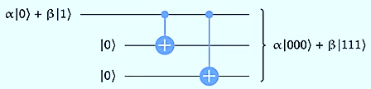


Trying Classical Repetition code for Qubits!
No Cloning (can’t repeat the qubit state!)
$$\left|ψ\right\rangle |ψ⟩|ψ⟩$$
Sate collapse when measured ( can’t detect the major vote)
But we can do this!!
Encoding
$$\left|ψ\right\rangle =α\left|0\right\rangle +β\left|1\right\rangle →α\left|000\right\rangle +β|111⟩$$
Entanglement!
GHZ state

Slide 11
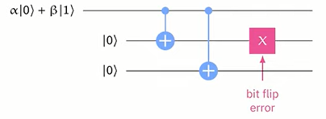
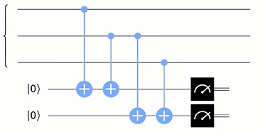


Detecting Bit-flip error – Parity checker
$$α\left|010\right\rangle +β|101⟩$$
00 | No bit flip error
01 | Error in bottom
10 | Error in top
11 | Error in middle
The state after encoding
SYNDROME

Slide 12
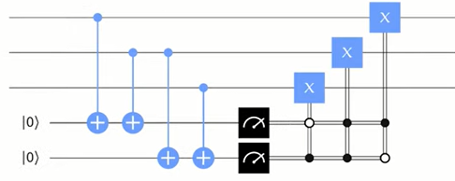
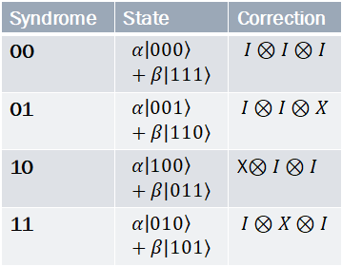
Correcting Bit-flip error
Syndrome | State | Correction
00 | $$α\left|000\right\rangle +β|111⟩$$ | $$I⊗I⊗I$$
01 | $$α\left|001\right\rangle +β|110⟩$$ | $$I⊗I⊗X$$
10 | $$α\left|100\right\rangle +β|011⟩$$ | X$⊗I⊗I$
11 | $$α\left|010\right\rangle +β|101⟩$$ | $$I⊗X⊗I$$

Slide 13
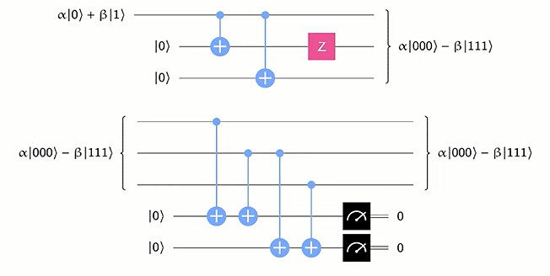
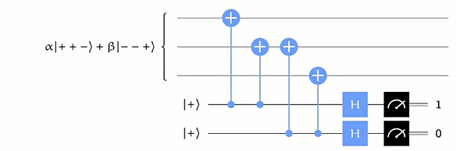
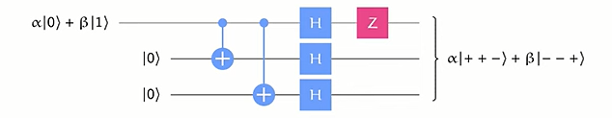


Detecting Phase-flip errors
3bit repetition code with encoding $\left|000\right\rangle +\left|111\right\rangle$fails to detect Z errors.
But we can do a trick!
$α\left|000\right\rangle +β\left|111\right\rangle →$ $α$|+++⟩$+β$|---⟩
$$Z\left|+\right\rangle =\left|−\right\rangle$$
$$Z\left|−\right\rangle =|+⟩$$
$$H\left|+\right\rangle =|0⟩$$
$$H\left|−\right\rangle =|1⟩$$
John Watrous - IBM

Slide 14
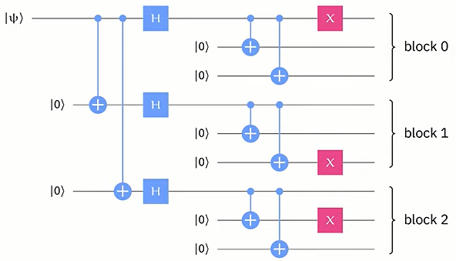
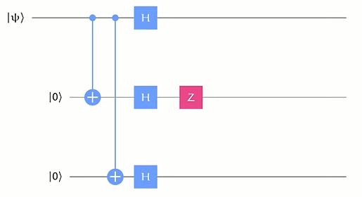
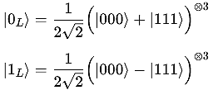
9 Qubit Shor code
Detecting and Correcting both X and Z errors
Other codes:
CSS codes
5-qbit Steane code
Codewords

Slide 15
Summarize
Stages of error correction with keywords of each stage:
Encoding: Entanglement
Detecting error: Parity checkers & Syndrome
Correcting error (decoding): X for bitflip or Z for phase flip
These parity checkers are what called Stabilizers

Slide 16

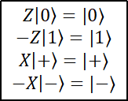



Stabilizer
Stabilizer is operator(s) (each is tensored Paulis) that leaves some valued state unchanged.
(+1 eigen value)
Stabilizer for 2D basis states
$$S\left|ψ\right\rangle =+|ψ⟩$$
Each stabilizer operator is Hermitian and can be measured as an observable.
The eigenvalues of stabilizer operators in a stabilizer code are always +1 or −1.
$$Z\left|0\right\rangle =|0⟩$$
$$−Z\left|1\right\rangle =|1⟩$$
$$X\left|+\right\rangle =|+⟩$$
$$−X\left|−\right\rangle =|−⟩$$
Example:
Consider $ψ=\frac{1}{\sqrt{2}}\left(\left|000\right\rangle + | 111\right\rangle$
This state which is the encoding in 3bit repetition code is stabilized by:
$$X⊗X⊗X$$
$$Z⊗Z⊗I$$
$$Z⊗I⊗Z$$
$$I⊗Z⊗Z$$
$$S_{1}=X⊗X⊗X$$
$$S_{2}=Z⊗Z⊗I$$
$$S_{3}=I⊗Z⊗Z$$
“Independent set of stabilizer generators”

Slide 17
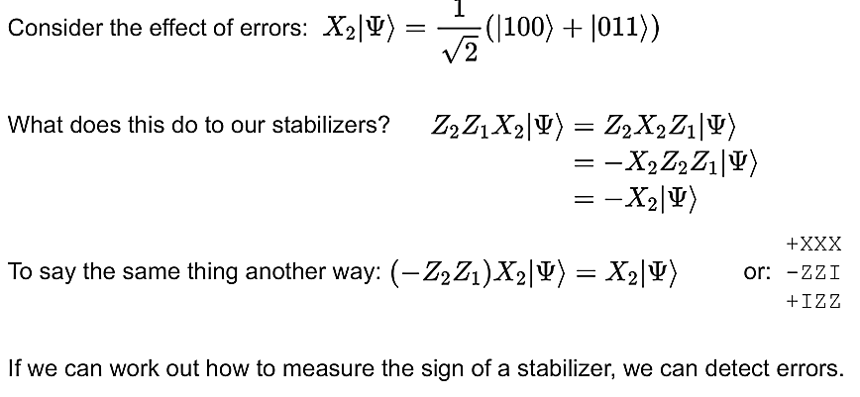
Role of Stabilizer in Detecting Errors

Slide 18
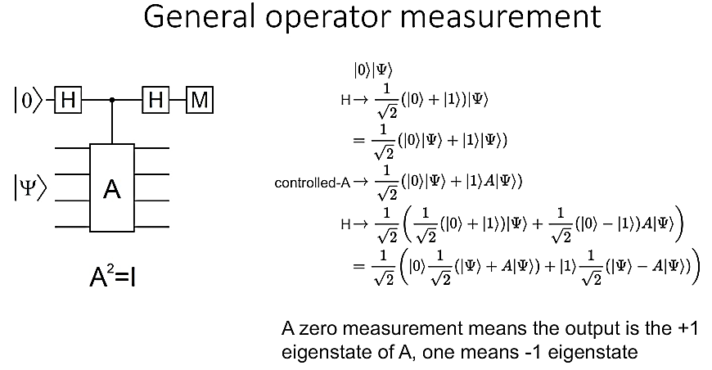

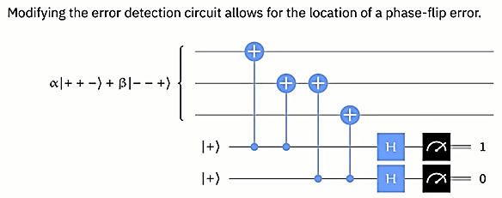
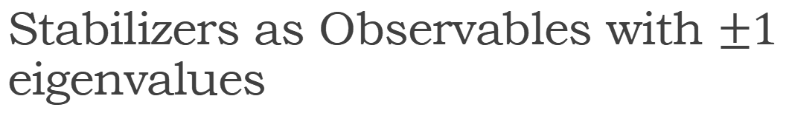
Stabilizers as Observables with $±1$ eigenvalues
Idea of detecting errors
Compare!

Slide 19
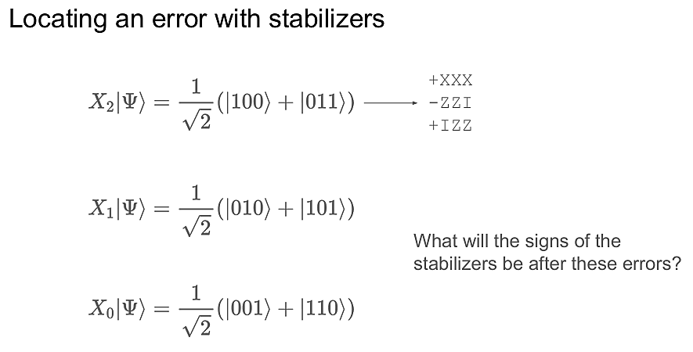


Exercise
Valid code space for all stabilizers
$$ψ=\frac{1}{\sqrt{2}}\left(\left|000\right\rangle + | 111\right\rangle$$
$$ZZI$$
$$IZZ$$
$$XXX$$

Slide 20
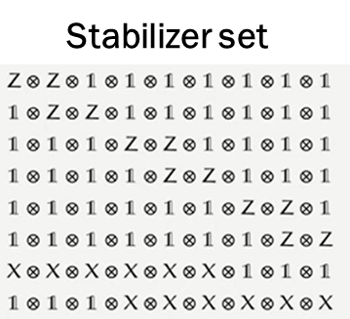


Stabilizer Codes & Code space
For any stabilizer code, the stabilizer generators (or stabilizers) are n-qubit Pauli operations (say, $P_{1},…P_{r})$ and should satisfy the following properties:
9-qubit Shore code
1. Commute with each other
$$P_{i}P_{j}=P_{j}P_{i}$$
2. Form minimum independent set
3. Have no trivial eigen state (null state)
$$−I^{⊗n}∉\{P_{1},…P_{r}\}$$
Code space contains all vector states that can be corrected by the stabilizer generators. So, it is defined by the stabilizers set $\{P_{1},…P_{r}\}$. It includes $2^{r}$ subspaces.

Slide 21




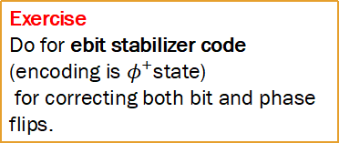


Useful Formula
G$iven r$ independent stabilizer generators acting on $n$ physical qubits, the number of logical qubits $k$the stabilizer code can protect against errors can protect against errors is determined as:
$$k=n−r$$
The dimension of the valid code space (encoding) is determined from the relation:
$$dimension=2^{n−r}$$
Example#1
3-bit repetition code (bit-flip)
Example#2
9-qubit Shor code
Exercise
Do for ebit stabilizer code (encoding is $φ^{+}$state)
for correcting both bit and phase flips.
$n=3, r=2$→ $l=1$ and the valid code space has dimension $2^{1}=2$
$n=9$ and $r=8$, then $2D$ valid code space and $1$ logical qubit.

Slide 22
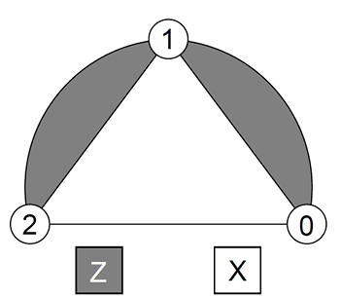


Graphing stabilizer code
Introducing the Surface Code
Codeword
$$\left|ψ\right\rangle =\frac{1}{\sqrt{2}}(\left|000\right\rangle +β|111⟩)$$
$$+ZZI$$
$$+IZZ$$
$$+XXX$$
Austun Fowler - Google

Slide 23
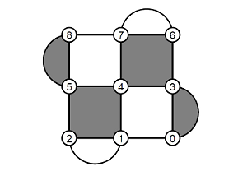
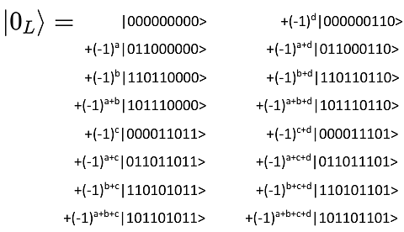
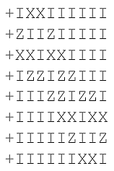
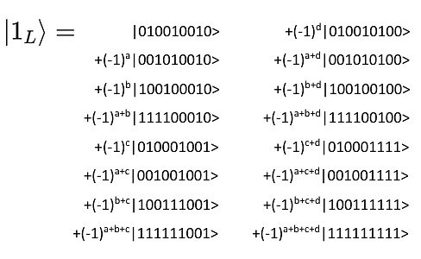

Introducing the Surface Code
Topological code

Slide 24
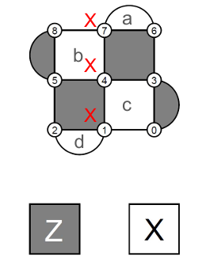
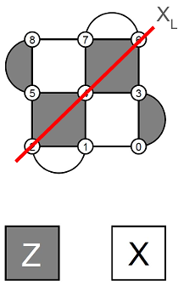
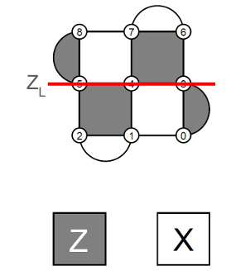






Introducing the Surface Code Logical Operations
Error-tolerant quantum computations
Example:
Commute with all stabilizers
$$IXIIXIIXI{\left|0\right\rangle }_{L}→{\left|1\right\rangle }_{L}$$
$$IIXIXIXII{\left|0\right\rangle }_{L}→{\left|1\right\rangle }_{L}$$
$${IIIIZZZIII\left|0\right\rangle }_{L}→ {\left|0\right\rangle }_{L}$$
$$X_{1}X_{4}X_{7}{\left|1\right\rangle }_{L}→{\left|0\right\rangle }_{L}$$
$$IIXIXIXII{\left|1\right\rangle }_{L}→{\left|0\right\rangle }_{L}$$
$${IIIIZZZIII\left|1\right\rangle }_{L}→{−\left|1\right\rangle }_{L}$$

Slide 25
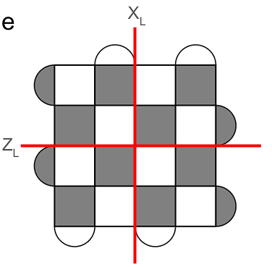
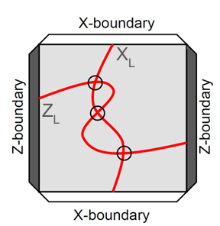
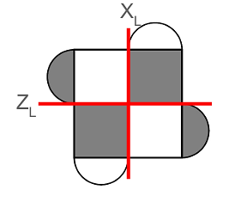

Surface Code
Topological code
Don’t need qubit numberings
$$Z_{L}$$
Distance 3 code
Distance 5 code
Arbitrary distance surface code

Slide 26
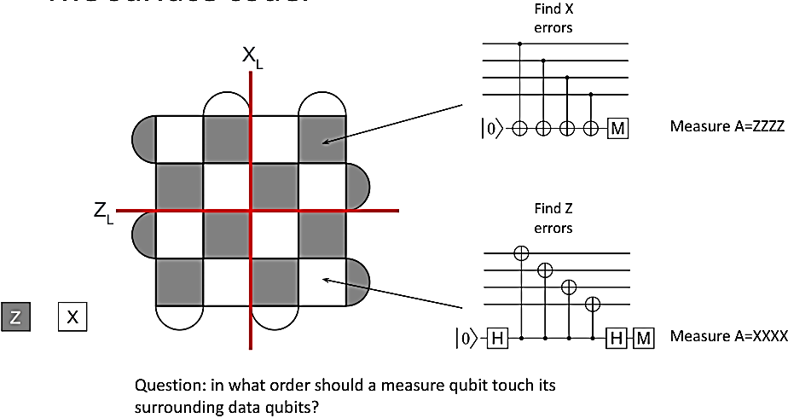
Data qubits -Measure qubits Interaction Timing

Slide 27
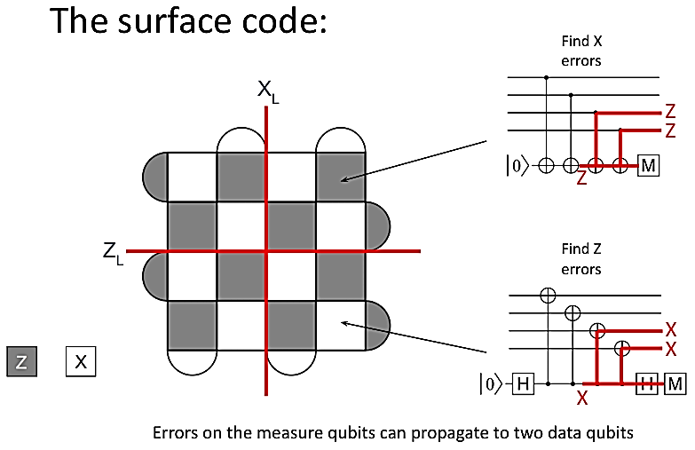
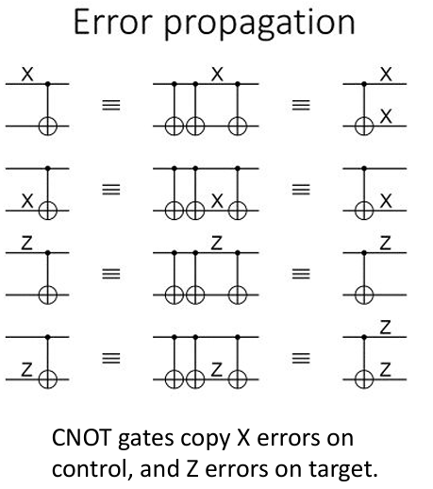
Data qubits -Measure qubits Interaction contd.

Slide 28
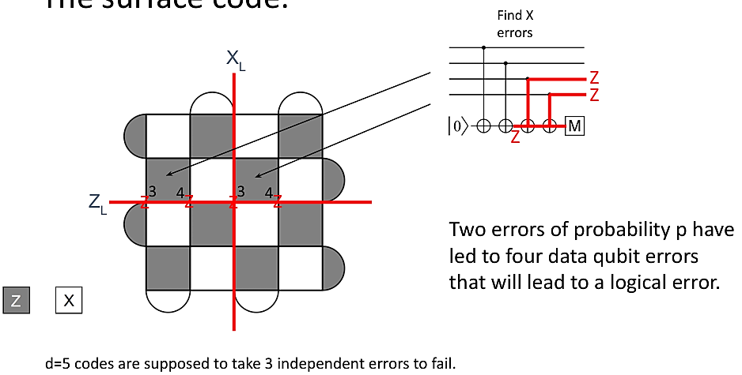
Data qubits -Measure qubits Interaction contd.

Slide 29
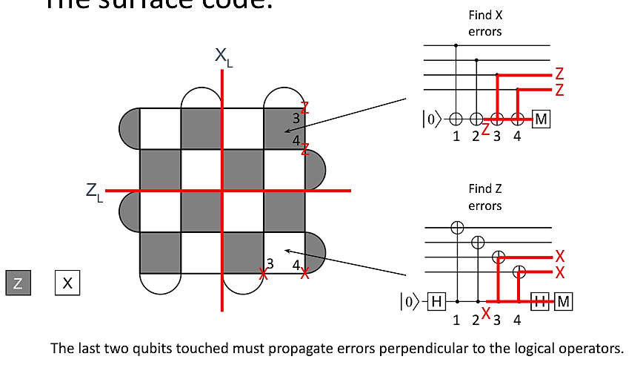
Surface Code Design

Slide 30
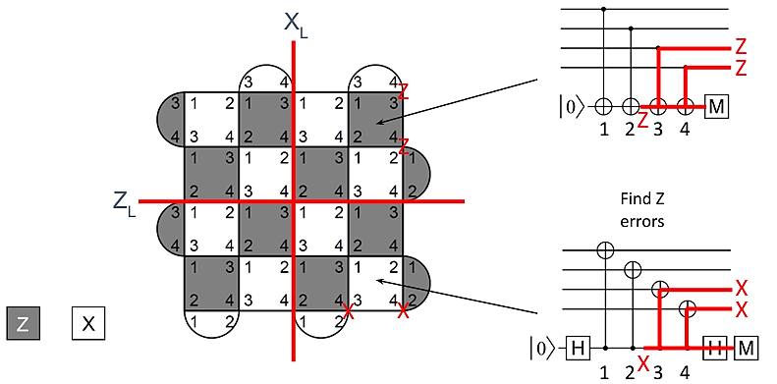
Surface code design contd.
Need global gate order that preserves the last two qubits touched rules and is perfectly parallel.

Slide 31
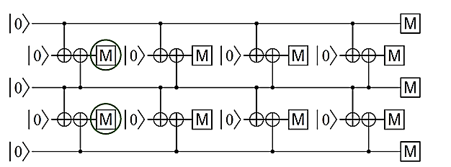

Surface Code Memory Experiment
Circuits that detect bit flips (Z stabilizers) have single measurement
detectors at the beginning as data qubits initialized to $|0⟩$ should
lead to the first measurement being 0

Slide 32



Quantum Error Detection
Detector
Detector
Sequential pairs of measurements with an expected parity in the absence of errors
Repetition code with no errors

Slide 33


Quantum Error Detection
Detection Event
Detection Event
Detector with an unexpected parity
One detection Event
Two detection Events
Error is in the upper data qubit
Error is in the middle data qubit

Slide 34




Quantum Error Detection
Resolving Unknown Errors
Use Minimum Weight Perfect Matching
$$weight=−\ln{p}$$
Won’t chose the low probability diagonal edge in this case
X
X
Provided errors are rare, random, and independent, d data qubits enables the detection and correction (in software) of up to $\frac{d−1}{2}$X errors

Slide 35

Surface Code Error Detection: 3D graphs
Qubit chip

Slide 36

Surface Code Error Detection: 3D graphs contd.
The thickness of each edge is proportional to the total probability of all errors leading to it.
Resolving by Minimum Weight Perfect Matching

Slide 37



STIM
Surface code circuits are rather large, Even for distance 5, the surface code is a complex 49 qubit circuit requiring complex error analysis and decoding

Slide 38

STIM Results
Logical errors exponentially suppressed with code distance up to the threshold point.
Threshold

Slide 39


LDPC codes
Low Density Parity Checks
Sergey Bravyi and others, paper: High-threshold and low-overhead fault-tolerant quantum memory, Nature 2024
  Properties:
  Not too many physical qubits involved in parity check at once
  Physical qubits shouldn’t be involved in too many of the checks
[[n,k,d]]
n = number of physical qubits
k = number of logical qubits
d = code distance

Slide 40
Thank You!

